Slide 1
Threads and Handlers

Slide 2
References
Threads in Java
Multithreading in Java
Thread States
Handlers in Android OS
Handlers
Communicate with Thread

Slide 3
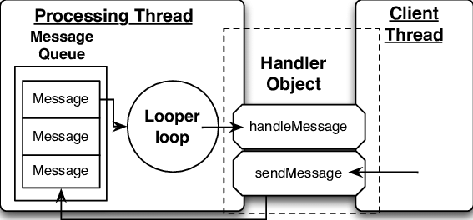
Threads, Loopers and Handlers

Slide 4
Threads, Loopers and Handlers
Android Looper, Handler, and Thread are among the building blocks of Android OS.
They are Android’s way of solving the problems of asynchronous programming.
They provide a neat structure on which a complex Android framework is built.

Slide 5
Model for Thread reusability
The thread is kept alive, in a loop via it’s run() method.
The task is executed serially by that thread and is maintained in a queue (MessageQueue).
The thread must be terminated when done.
The above model is implemented in the Android via Looper, Handler, and HandlerThread.

Slide 6
Model for Thread reusability
MessageQueue is a queue that has tasks called messages which should be processed.
Handler enqueues task in the MessageQueue using Looper and also executes them when the task comes out of the MessageQueue.
Looper is a worker that keeps a thread alive, loops through MessageQueue and sends messages to the corresponding handler to process.
Finally Thread gets terminated by calling Looper’s quit() method.

Slide 7
Creating Looper and MessageQueue for a Thread
A thread gets a Looper and MessageQueue by calling Looper.prepare() after its running.
Looper.prepare() identifies the calling thread, creates a Looper and MessageQueue object and associate the thread with them.
Looper.loop()must be called to start the associated looper.
Similarly, the looper must be terminated explicitly through looper.quit().

Slide 8
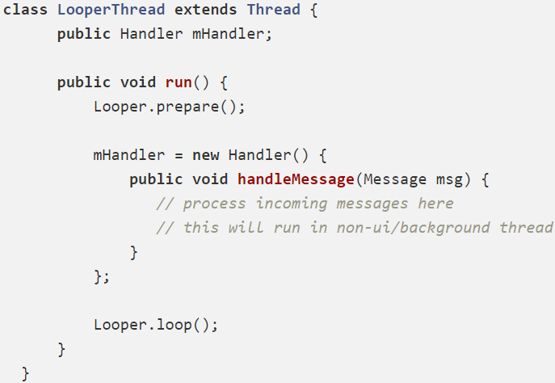
Creating Looper and MessageQueue for a Thread

